Slide 1
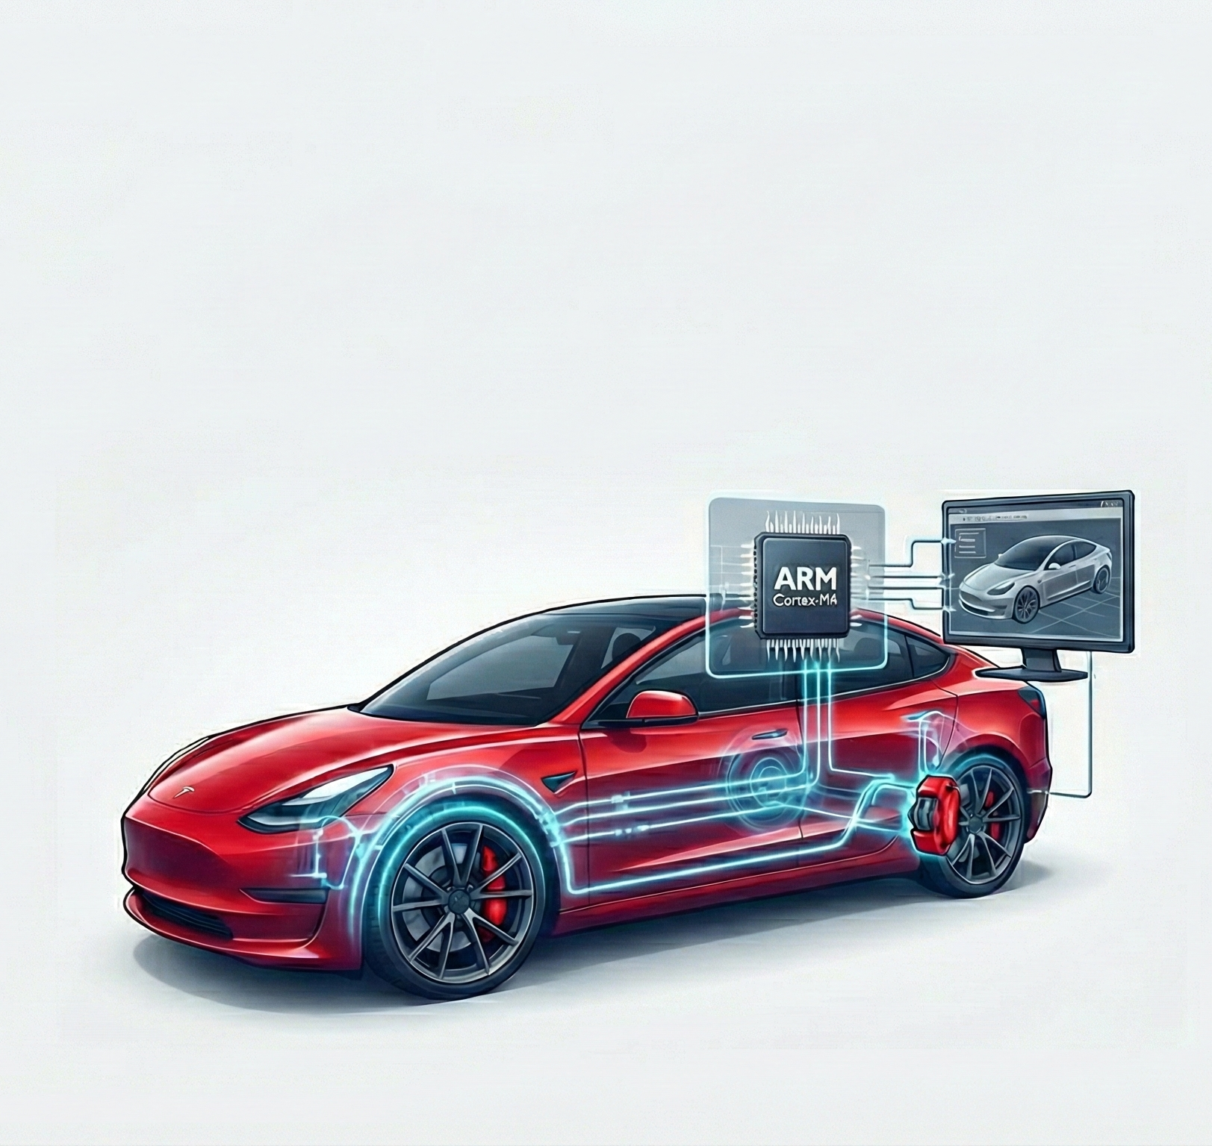
Simulation-Based Design and Processor-in-the-Loop Validation of a Blended Braking System for a Sport Electric Vehicle using an ARM Cortex-M4Processor
Lakshay Taneja (26031)
Indian Institute of Science (IISc)

Slide 2
Problem Statement & Objective
The Challenge: Electric Vehicles (EVs) must balance Energy Recovery (Regenerative Braking) with Safety (Friction Braking). Pure friction braking wastes range; pure regen lacks stopping power in emergencies or at full charge.
The Objective: Design a controller that dynamically splits torque demand between the Electric Traction Motor and an Electro-Mechanical Brake-by-Wire (BBW) Actuator.
Key Goals:
Maximize Driving Range via aggressive energy recovery.
Ensure seamless deceleration by compensating for Regen fade at low speeds.
Validate the control logic on actual hardware (STM32F446RE).

Slide 3
System Architecture (The Plant Model)
Vehicle Dynamics:
Forward-facing model based on Newton's Second Law (F=ma).
Class: Lightweight Sport EV.
Mass: 1600 kg (Optimized for agility).
Aerodynamics: High-efficiency Drag Coefficient (C_{d}) = 0.22. Frontal Area = 2.2 sq. m.
Rolling Resistance: C_{rr} = 0.008 (Low-rolling-resistance EV tires).
Powertrain:
Topology: Pure Battery Electric Vehicle (BEV).
Motor Efficiency: Dynamic map (approx. 95%).
Propulsion: Electrical Power = Mechanical Power / Efficiency.
Regen: Electrical Power = Mechanical Power * Efficiency.
Battery: 50 Ah High-Voltage Performance Pack (350V - 420V).
Actuators:
Regen: Dynamic Torque control via Motor Inverter.
Friction: Electro-Mechanical BBW Actuator (10ms response time).

Slide 4
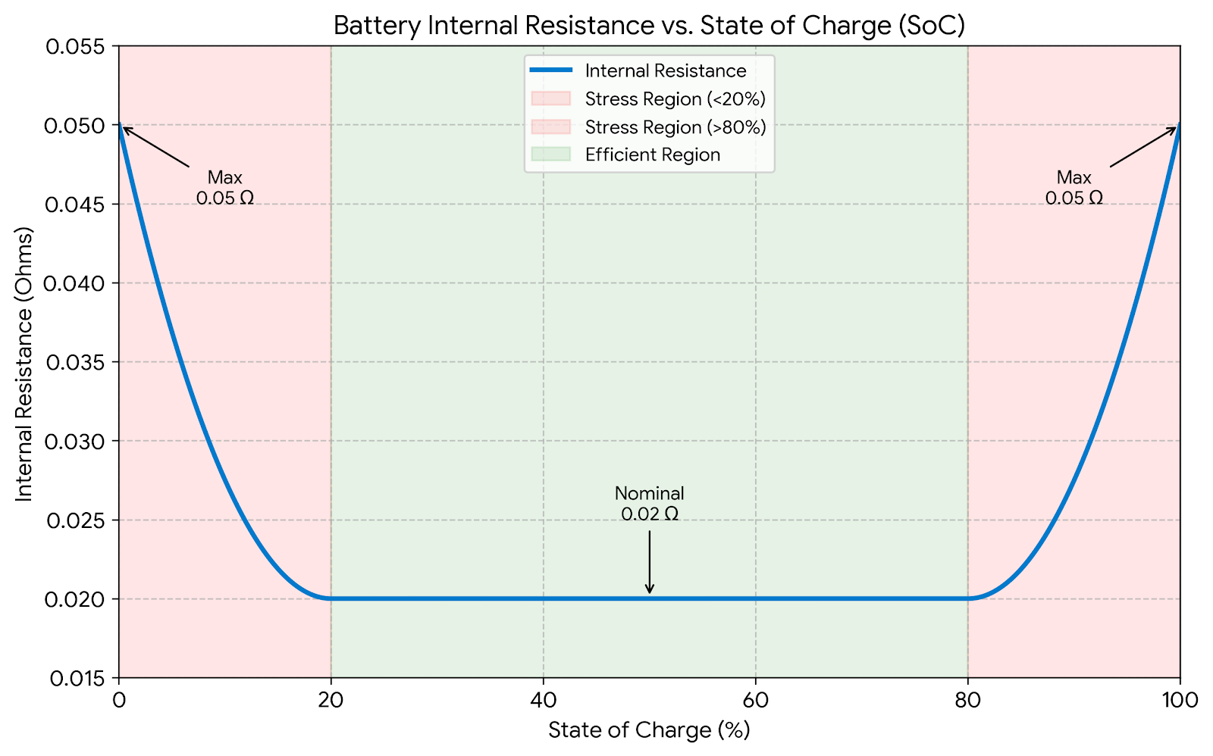
Battery Modelling (Thevenin Equivalent)
Topology: Dynamic Voltage Source with Internal Resistance.
Non-Linear Characteristics:
Open Circuit Voltage (V_{oc}): Linear drop from 420V (100% SoC) to 350V (0% SoC), simulating Li-Ion cell discharge curves.
Internal Resistance (R_{int}): Implemented as a “Bathtub Curve”.
Nominal: 0.02 Ohms (Efficient operation range).
Extremes: Rises to 0.05 Ohms at low (<20%) and high (>80%) SoC, simulating thermal stress.
Current Integration: Coulomb counting method utilized to track SoC changes in real-time.
Fig., Bathtub Curve

Slide 5
Controller Logic & Tuning (The Brain)
Propulsion Logic:
Max Torque: 2800 Nm (Software Limited).
Speed Governor: Hard cap at 45 m/s (162 km/h) with a 5 m/s soft-cut fade region to protect the drivetrain.
Braking Logic:
Max Brake Demand: -4500 Nm (Calibrated for approx. 0.9g emergency deceleration).
One-Pedal Coasting: -300 Nm regenerative drag applied automatically at 0% throttle.
Deadband: 5% (0.05) input threshold to eliminate potentiometer noise and "ghost braking.“
Regen Constraints (Torque-Speed Envelope):
Regen torque drops at high speed because motor back-EMF approaches battery voltage, limiting safe inverter current.
Low Speed (0 - 10 m/s): Ramps from 0 to -2500 Nm to prevent jerk.
Constant Torque (10 - 25 m/s): Peak regen of -2500 Nm available.
Constant Power (> 25 m/s): Torque derates to -1200 Nm at 45 m/s to respect motor limits.

Slide 6
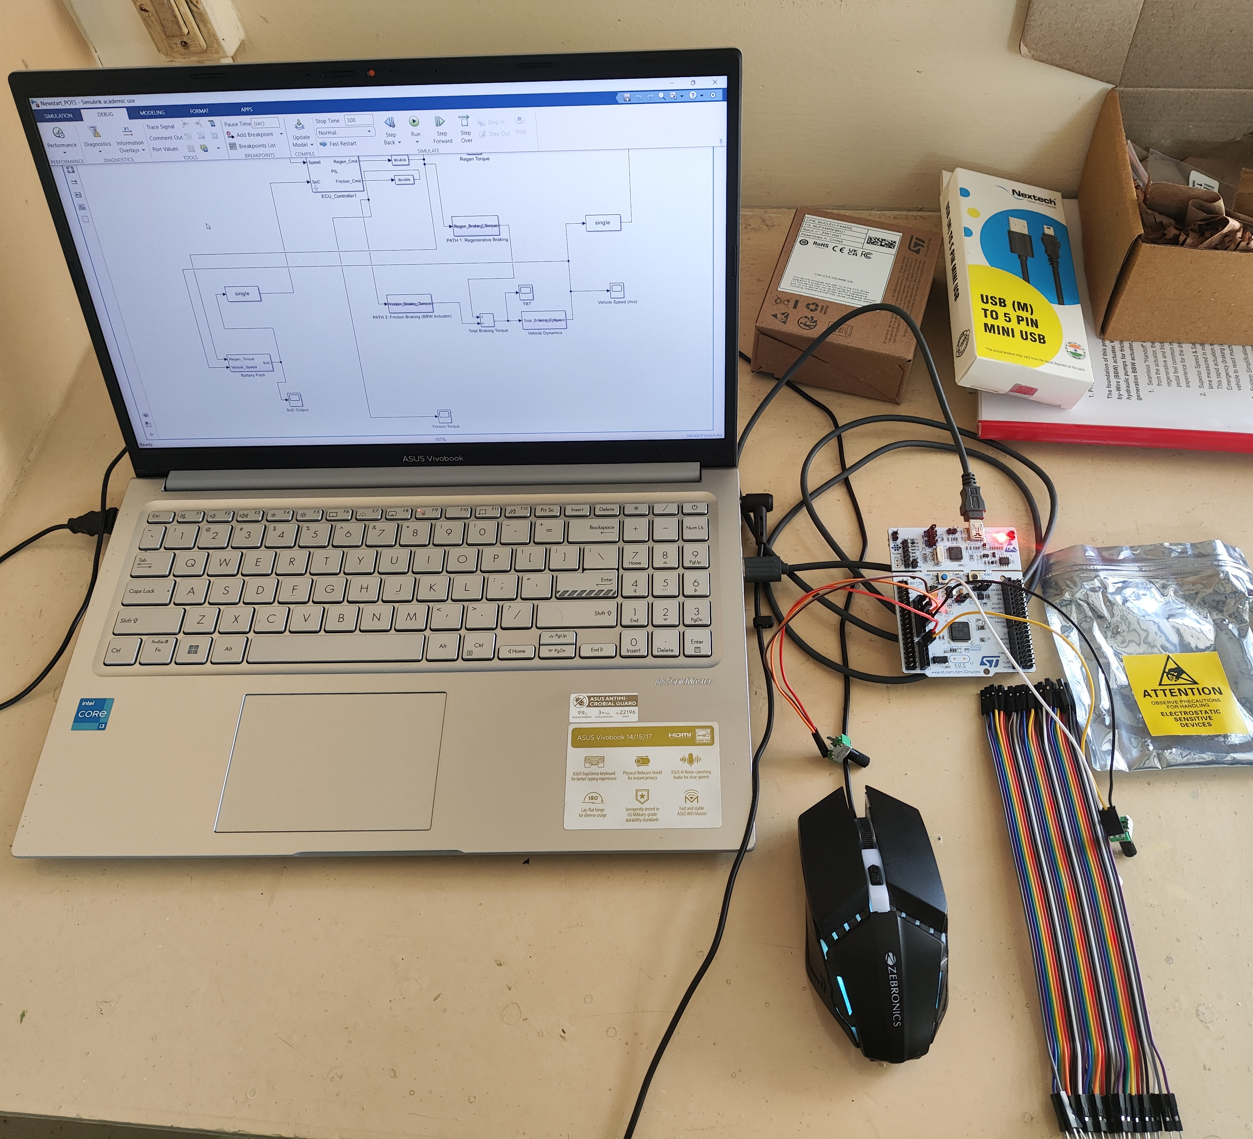
Hardware Implementation (PIL + HIL)
Validation Methodology: Processor-in-the-Loop (PIL) with Hardware-in-the-Loop (HIL) Inputs.
Microcontroller: STM32 Nucleo-F446RE (ARM Cortex-M4).
Driver Interface (HIL):
Inputs: Two 10 kOhm linear rotary potentiometers (Accelerator & Brake).
ADC: 12-bit raw values (0-4095) scaled to float (0.0 - 1.0) within the embedded code.
Key Engineering Optimizations:
Data Type: Converted Plant (Double Precision) to Controller (Single Precision) to match FPU capabilities of Cortex-M4 architecture.
Drivers: Utilized LL (Low-Layer) drivers for ADC/DMA to ensure a stable 100Hz control loop.
Clock: Synced Hardware Clock to 180 MHz for accurate Serial Baud Rate (115200).

Slide 7
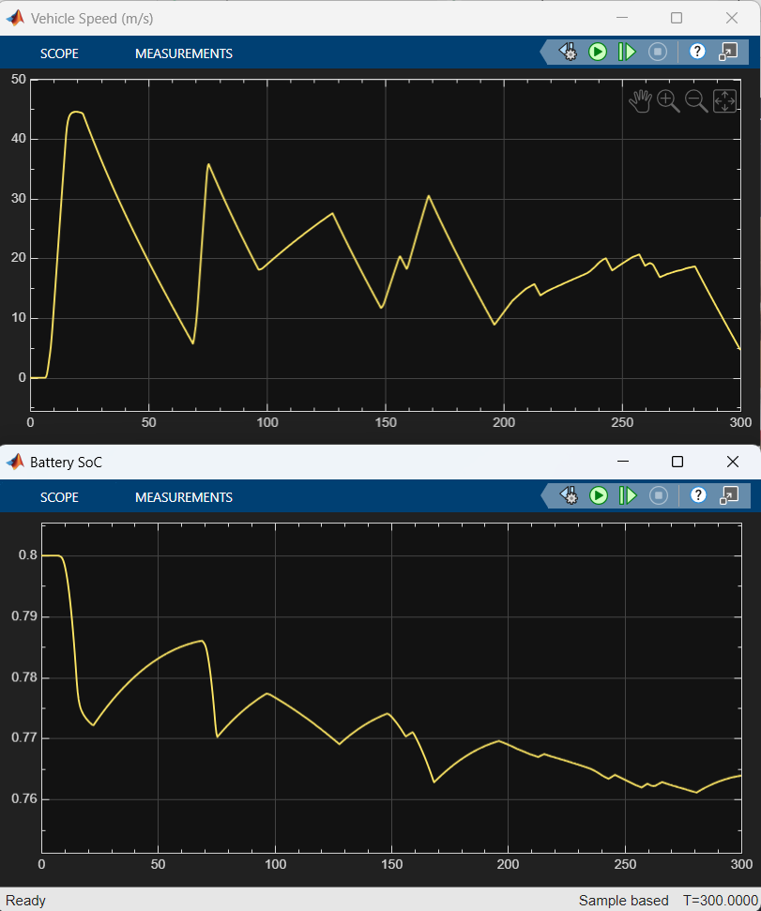
Validation Results - 1 (Regen & Coasting)
Test Scenario: Vehicle accelerates to 40 m/s, then driver releases accelerator (Input = 0).
Observation:
Vehicle speed decays smoothly, verifying the -300 Nm One-Pedal tune.
Battery SoC Rises: Confirms the motor successfully switched to Generator Mode, converting kinetic energy to chemical energy.
Conclusion: Energy Recovery System is functional and physically valid.

Slide 8
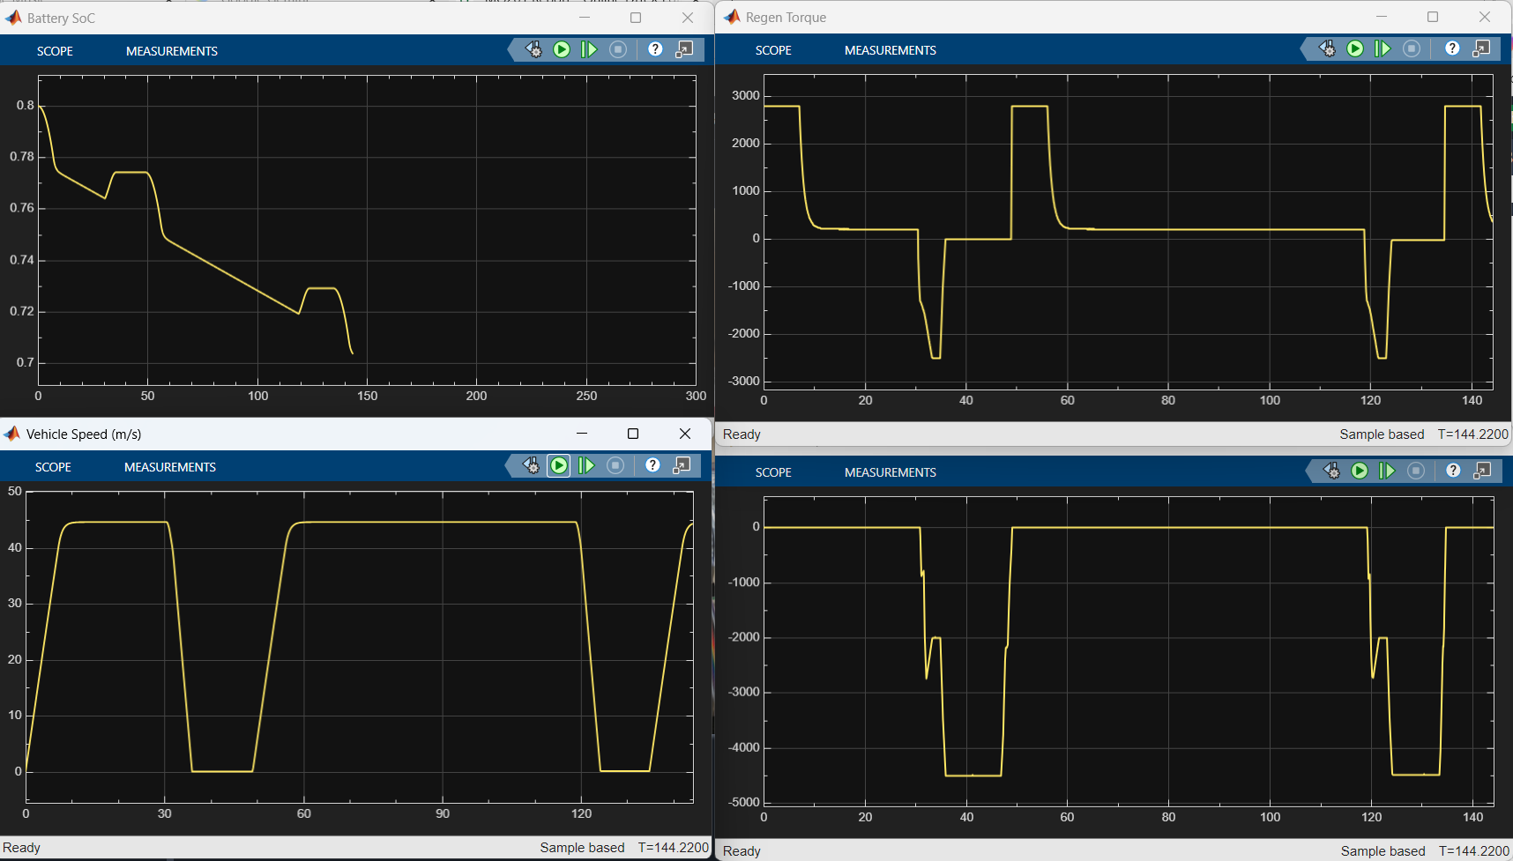
Validation Results - 2 (Blended Stop)
Test Scenario: Driver applies 100% Brake Pedal input at 43 m/s (155 km/h).
Observations:
Regen Behaviour: Initially peaked at -1200 Nm (Field Weakening limit), then linearly increased to -2500 Nm as speed dropped.
Friction Handoff: Friction brakes immediately filled the torque gap.
Performance: Vehicle stopped in < 4.5s at steady 1.0g deceleration. Dynamic blending successfully validated.
Energy Dynamics:
Current Reversal: Motor current switches to negative (flowing into the battery), confirming the battery is charging even during a panic stop.
SoC Impact: Battery State-of-Charge remains stable because the braking event is too short (< 4.5s) to accumulate significant energy.
Conclusion: The system prioritizes safety (1.0g deceleration) over energy recovery during emergency maneuvers, successfully managing the handoff between actuators.

Slide 9
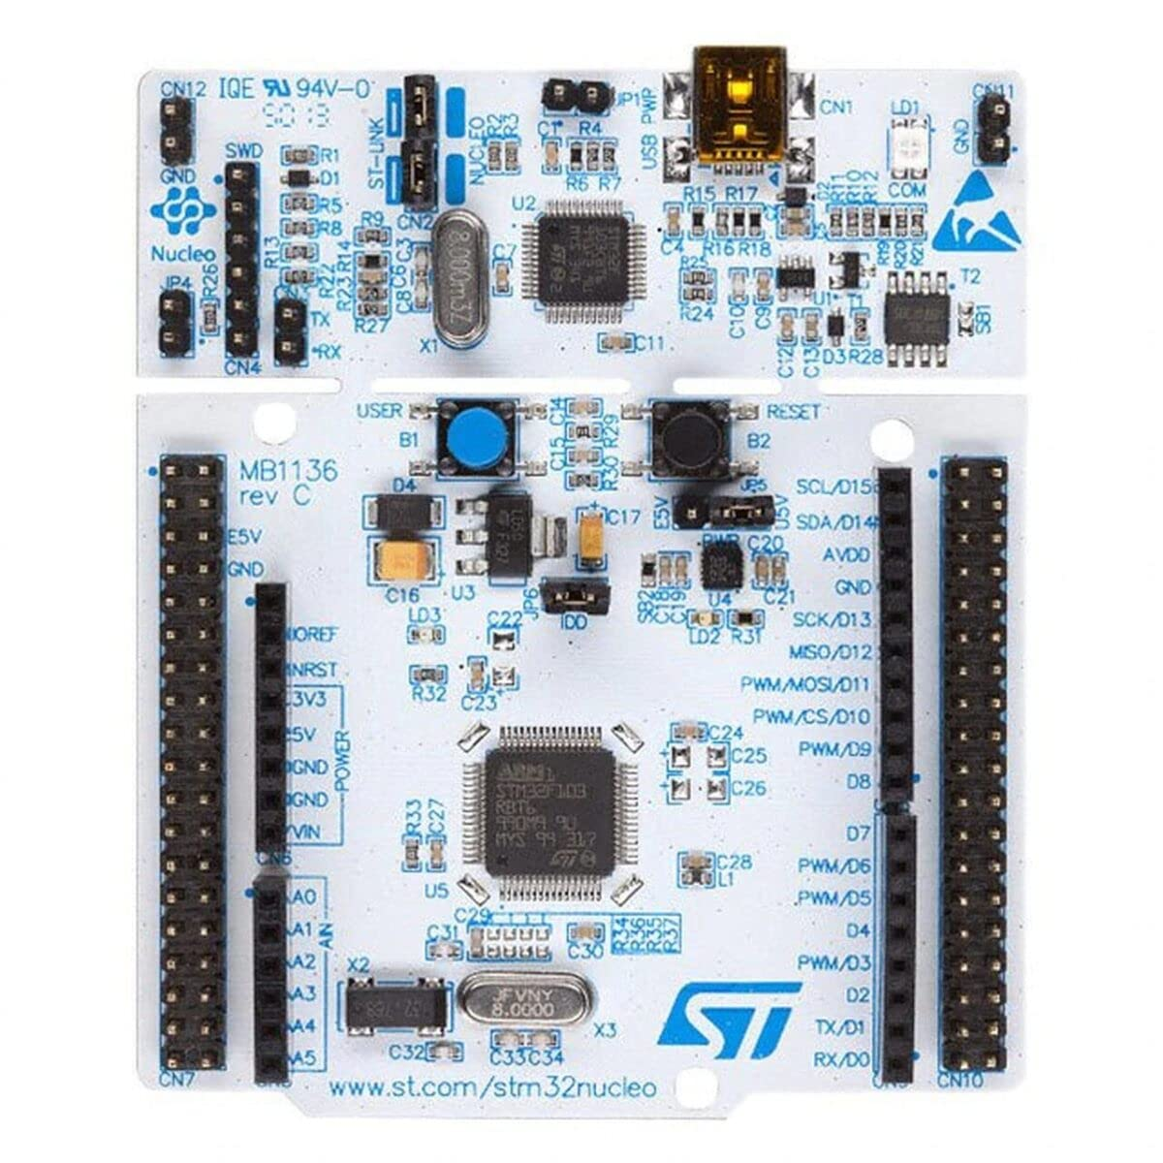
Conclusion
Successfully engineered a Cyber-Physical System integrating simulated EV physics with real embedded hardware.
Validated the Blended Braking Algorithm under real-time constraints using an STM32F446RE.
Demonstrated Hardware-in-the-Loop (HIL) capability using physical driver inputs (Potentiometers) to drive a simulated Sport Electric Vehicle.

Slide 10

ABS & ESC: Implement slip-ratio control and yaw-moment stabilization (Electronic Stability Control).
State Estimation: Deploy an Extended Kalman Filter (EKF) for precise battery SoC tracking under dynamic loads.
Future Roadmap & Developer Profile
Advanced Safety & Dynamics
GitHub: LakshyaTaneja/Sport-EV-Blended-Braking-PIL: Simulation-Based Design and Processor-in-the-Loop (PIL) Validation of a Blended Braking System for a Sport Electric Vehicle (EV) using an ARM Cortex-M4 Processor.

